Slide 1
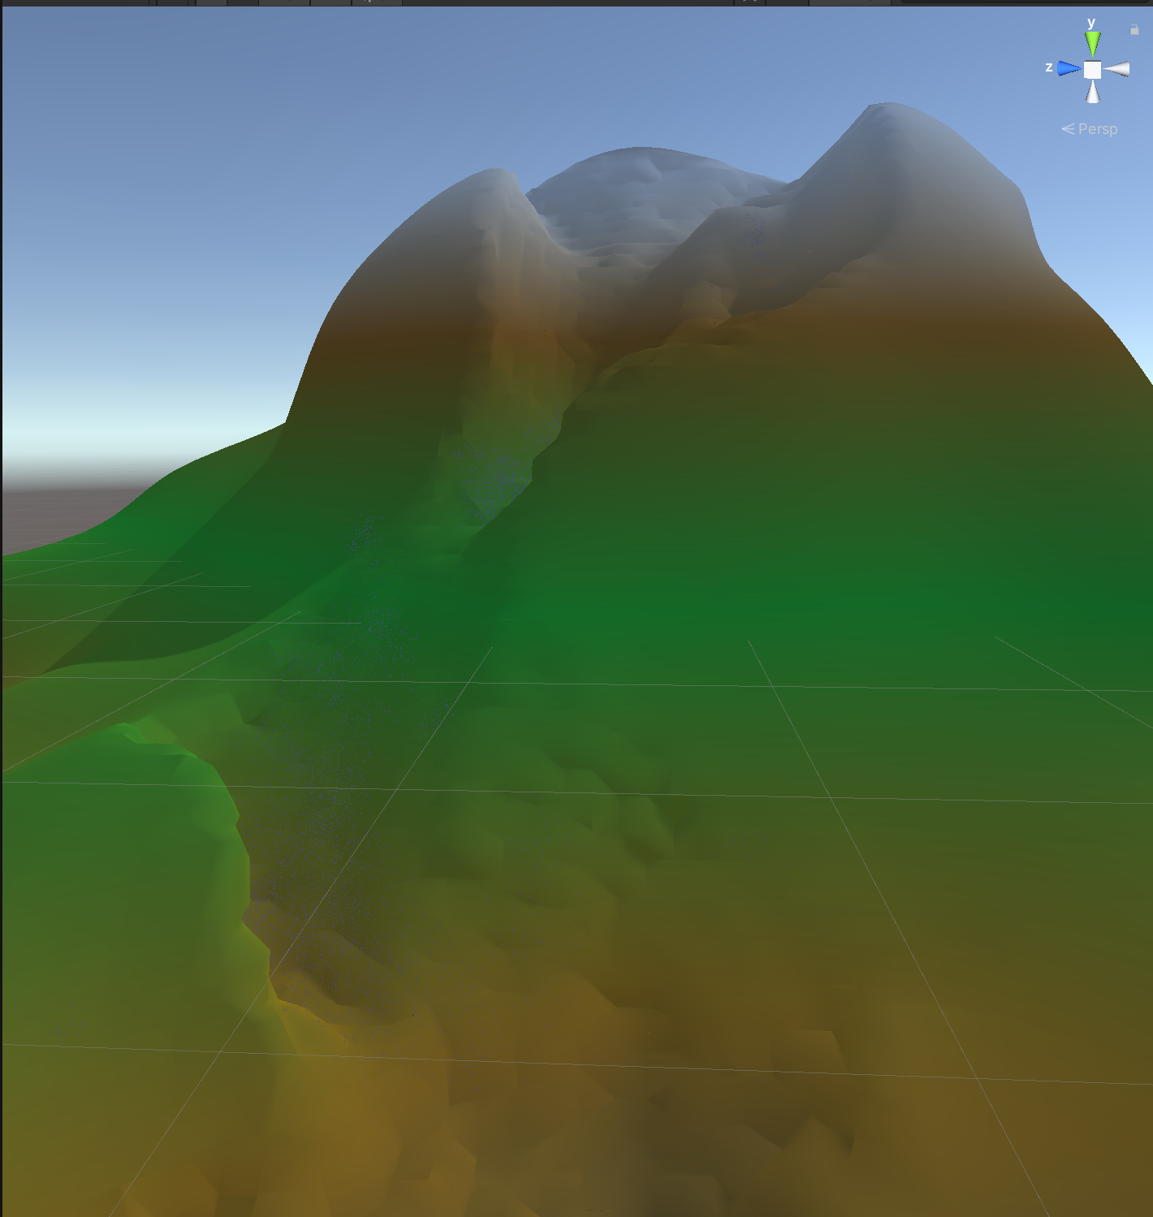
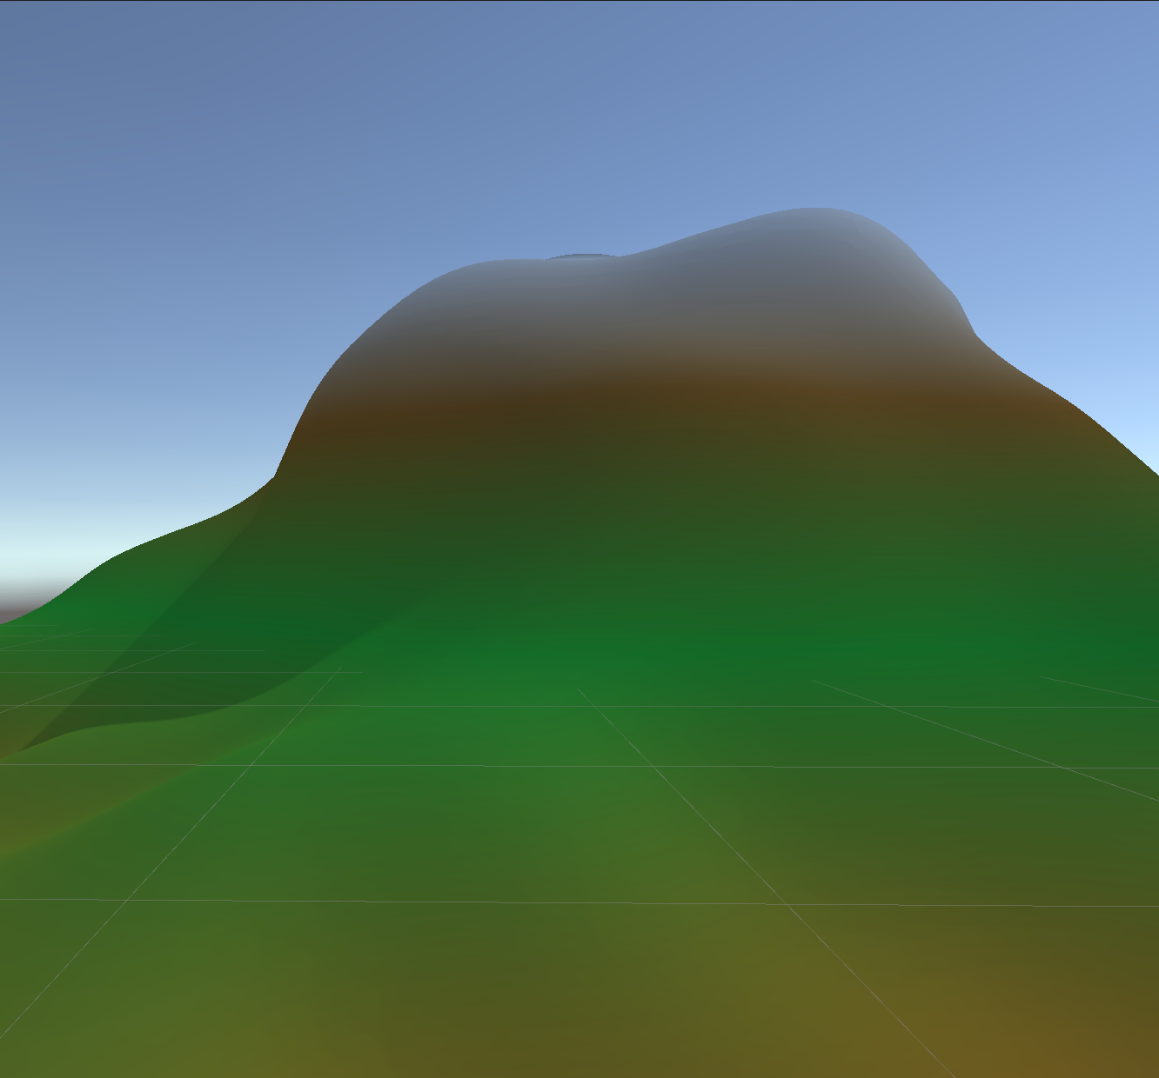
Terrain Modification with fluid simulation using doubly-coupled PCISPH

